Slide 1

DMH1F4 – SISTEM BASIS DATA
Semester Ganjil 2016/2017
QUERY PROCESSING 1
Disajikan oleh : Tim Pengajar Sistem Basis Data
Hanya dipergunakan untuk kepentingan pengajaran di lingkungan Telkom University

Slide 2
Steps in Query Processing
1. Parsing and translation
2. Optimization
3. Evaluation

Slide 3
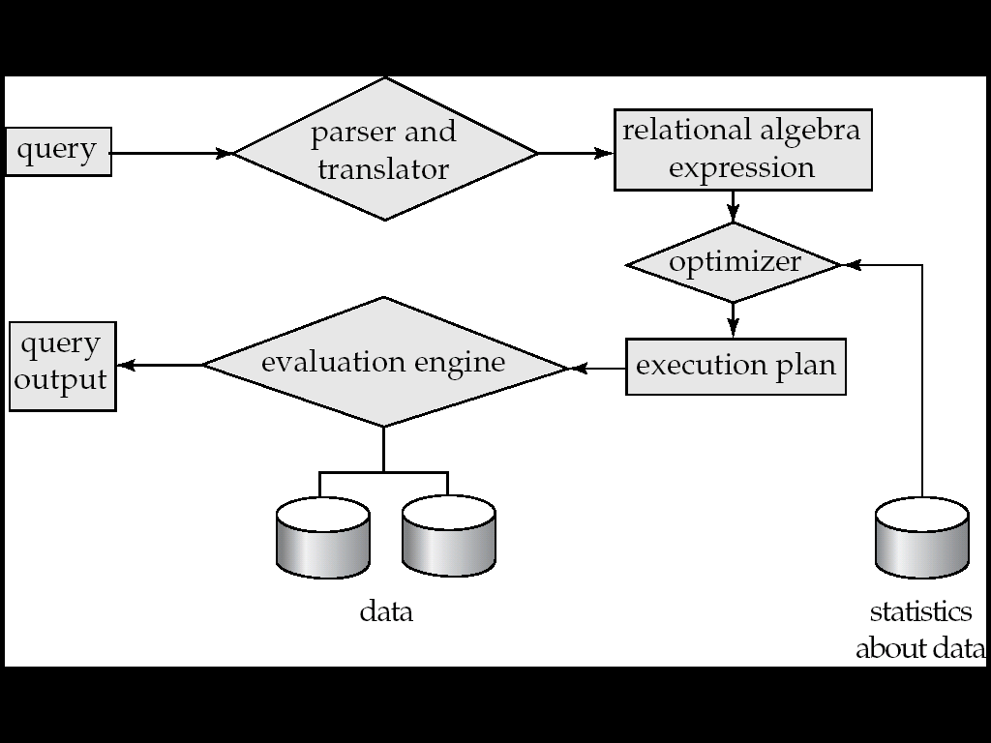
Steps in Query Processing

Slide 4
Steps in Query Processing
Parsing and translation
Translate the query into its internal form.
Translation is similar to the work performed by the parser of a compiler
Parser checks syntax, verifies relations
Parse tree representation
This is then translated into RA expression

Slide 5
Steps in Query Processing
Query Execution Plan
In SQL, a query can be expressed is several ways
Each SQL query can itself be translated into RA expression in many ways
An RA expression only partially tells you how to evaluate a query
Several ways to evaluate RA expression
Annotate RA expression with instructions specifying how to evaluate each operation
Annotation may state the algorithm to be used for a specific operation or the particular index to use

Slide 6
Steps in Query Processing
Evaluation
The query-execution engine takes a query-evaluation plan, executes that plan, and returns the answers to the query.

Slide 7
Steps in Query Processing
Example
select balance
from account
where balance < 2500
RAEs
σ_{balance<2500}(∏_{balance}(account))
∏_{balance}(σ_{balance<2500}(account))
E.g., we can use an index on balance to find accounts with balance < 2500,
or can perform complete relation scan and discard accounts with balance ≥ 2500

Slide 8
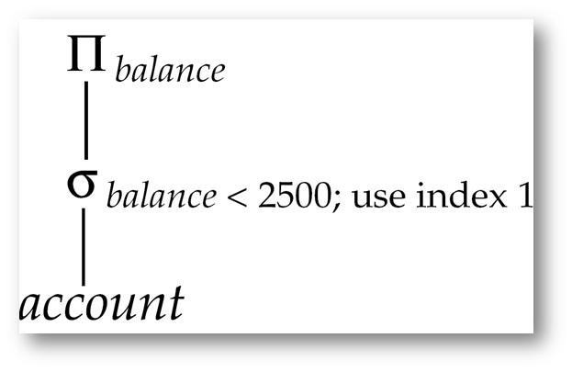
Steps in Query Processing
Query execution plan

Slide 9
Steps in Query Processing
Query Optimization
Different QEPs for a given query can have different costs
Users not expected to write their queries in a way that suggests the most efficient QEP
It is the system’s responsibility to construct a QEP that minimizes the cost

Slide 10
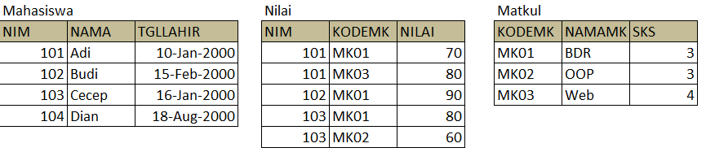
Latihan
Diketahui tabel-tabel berelasi sebagai berikut:
Gunakan konsep Query Processing untuk menentukan NIM, Nama, NamaMK dan Nilai setiap Mahasiswa!

Slide 11
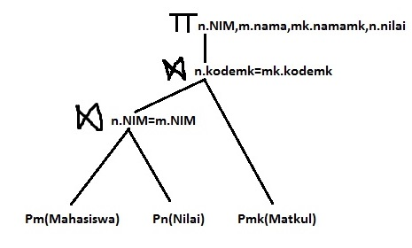
Latihan (Solusi)
SELECT n.NIM,m,nama,mk.namamk,n.nilai
FROM
Nilai n JOIN Mahasiswa m ON n.NIM=m.NIM
JOIN Matkul mk ON n.kodemk=mk.kodemk

Slide 12
SELESAI

